Slide 1


QUAKE
Zishan Sami
Harshit Anand

Slide 2


In order to approach the problem, we used Python and the module used was Scikit Learn.

Slide 3
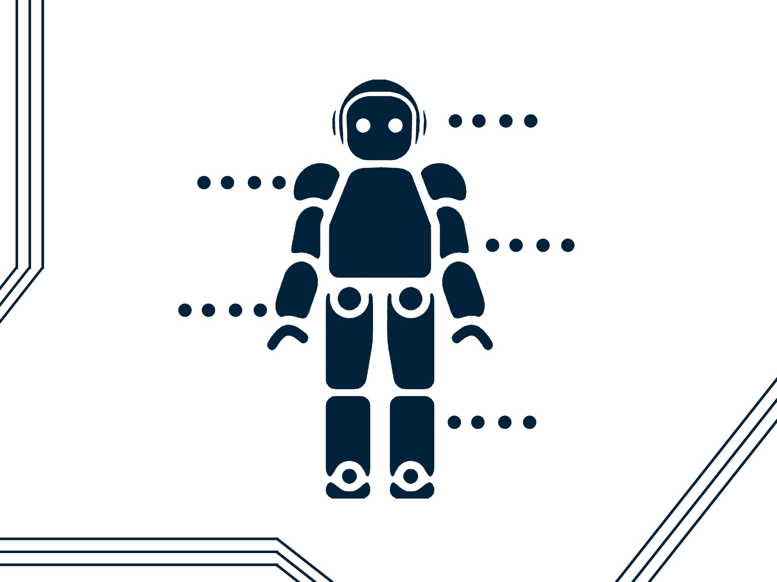
Index
Variable Selection
Data
Pre- processing
Model Selection
& Confusion Matrix
Threshold
Selection
Accuracy
Analysis

Slide 4
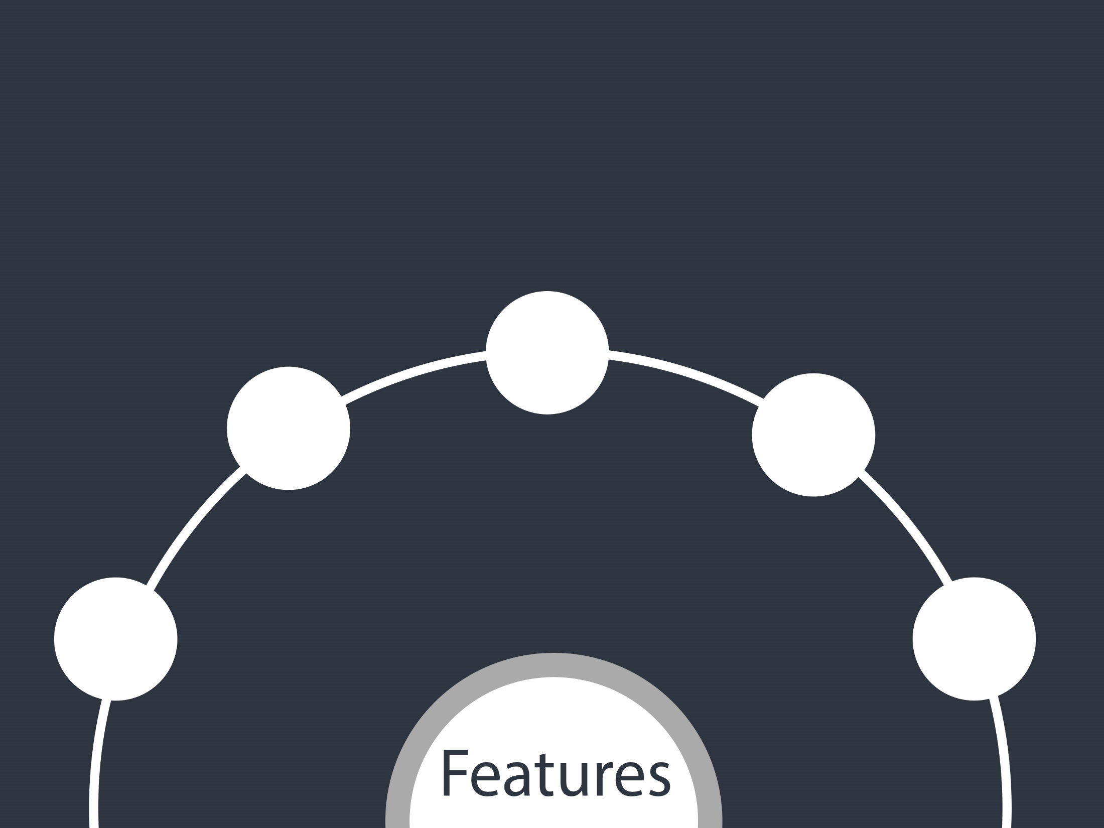
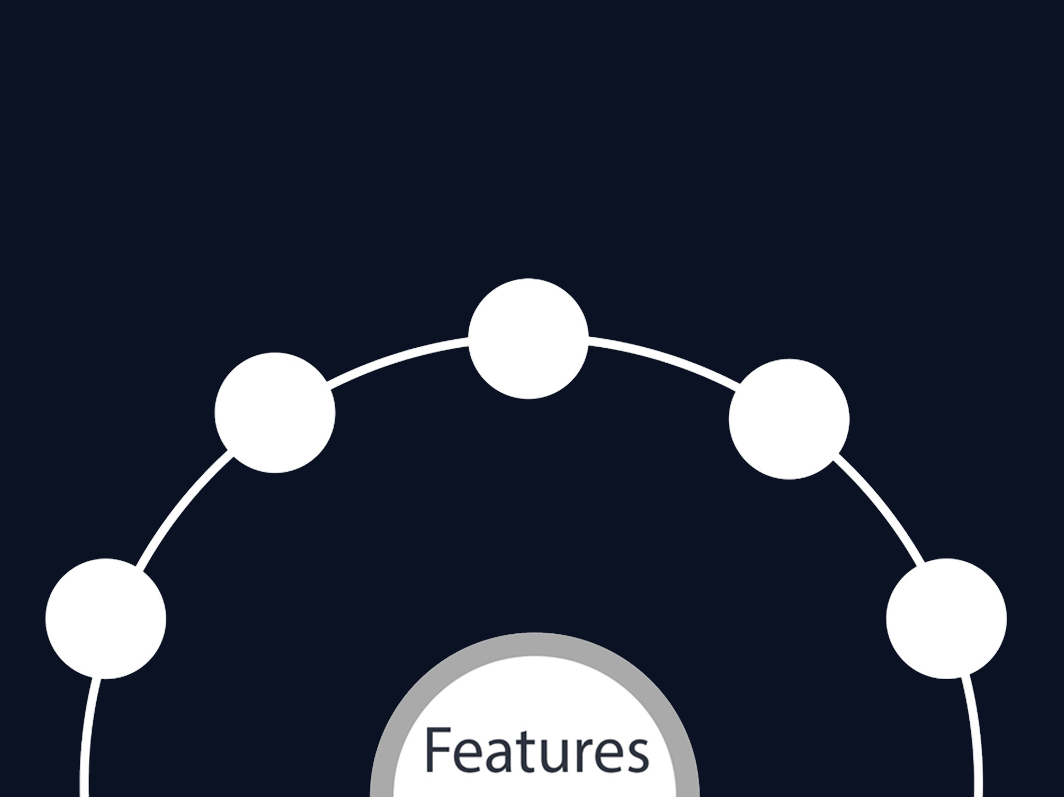
Variable
Analysis
Model
Selection & Confusion Matrix
Data
Pre-
processing
Accuracy
Analysis
Threshold
Selection
Index

Slide 5

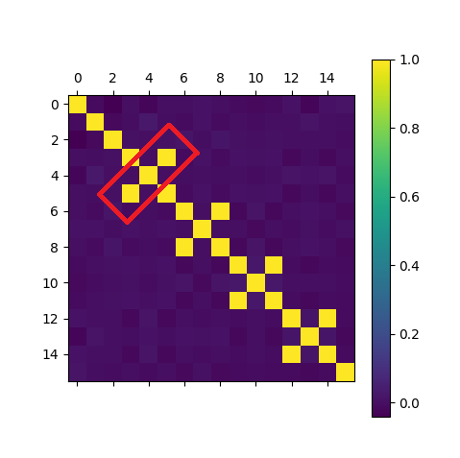
Variable Analysis
High Correlation between certain equally spaced variables was observed
These variables were identified to be total_*_minutes and Total_*_charges
We derived one feature out of these two using Principal Component Analysis(PCA)

Slide 6

Data
Pre-
processing
Model
Selection & Confusion Matrix
Variable
Analysis
Accuracy
Analysis
Threshold
Selection
Index

Slide 7
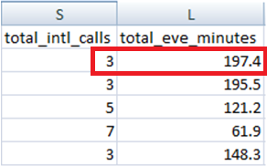

Data Pre- processing
After the variable selection and normalization of some features was done to match the scale.
We converted some features which were in string format('yes/no') into Boolean(1/0).
Removing of variables like area_code, phone_number, state & id.
Large Difference in values

Slide 8
Dataset Split
The Dataset was split into
Train Data: Used to train the different models
Validation Data: Used to test the different models and find respective Area Under ROC Curve, sensitivity, specificity and precision. Threshold selection was done using this.
Test Data: Separate Dataset strata on which the validated model was tested upon to find the various parameters. This dataset can be thought of as an unknown Dataset on which the model can be applied.
The total Dataset of 5000 was split into 3500:750:750 for Train, Validation and Test data respectively.

Slide 9
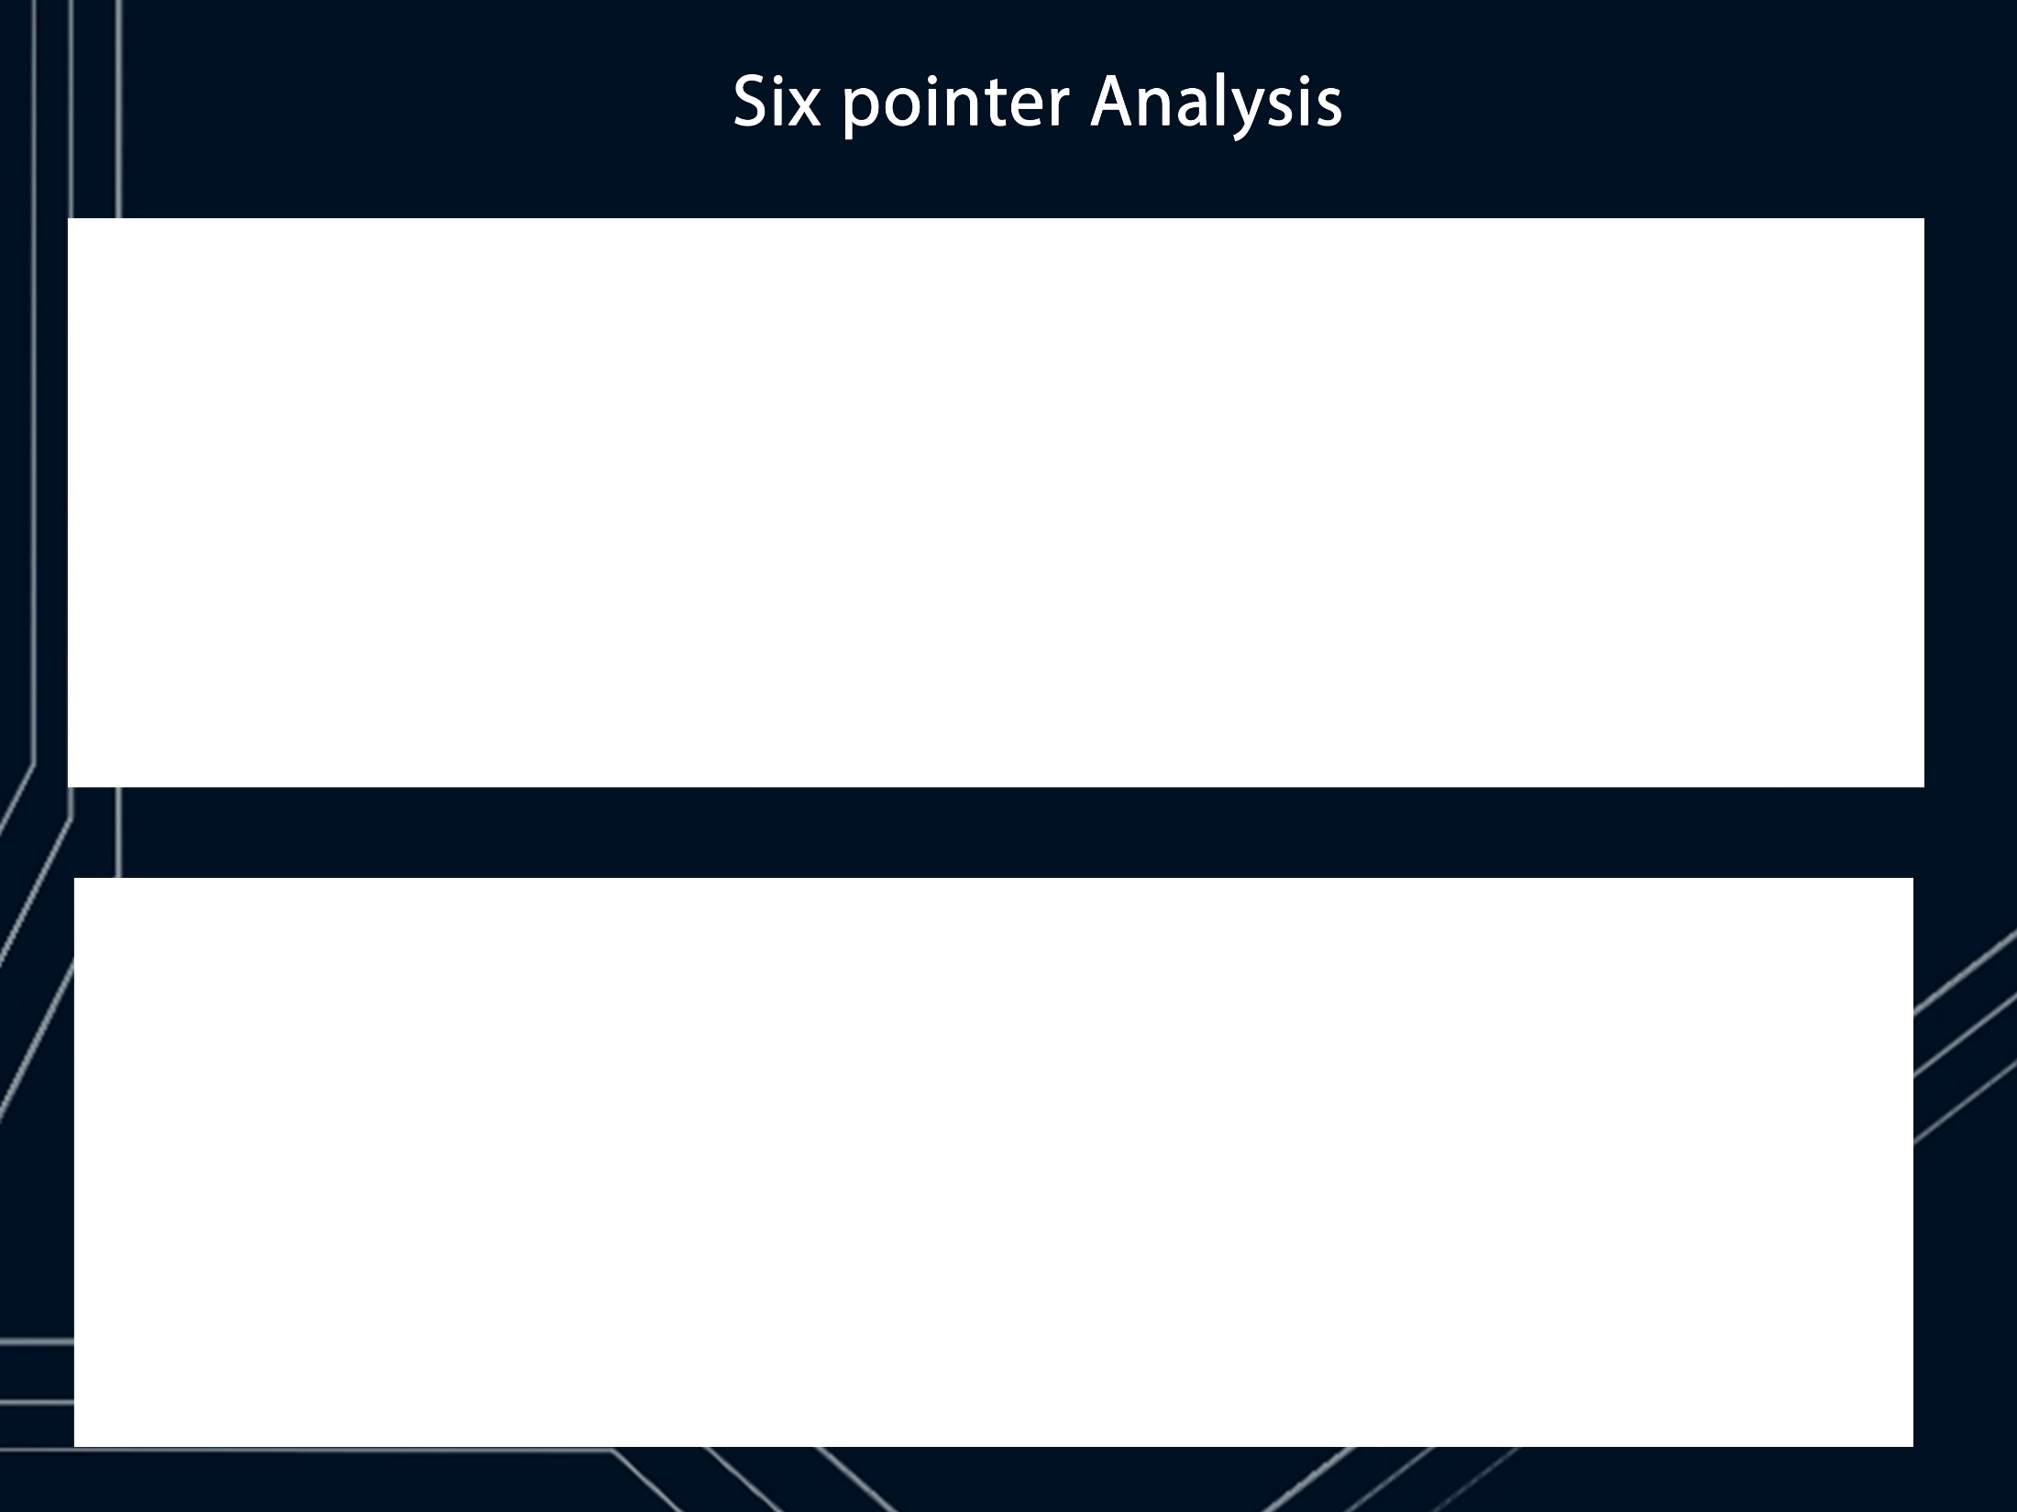
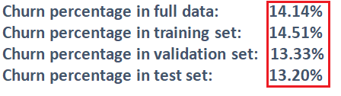
Transportation Infrastructure Analysis
Autonomous vehicles will expect to communicate with sensors ,including and especially traffic lights, traffic management systems linked to CCTV networks and embedded road sensor.
From 2012 to 2020, $117bn will be invested worldwide on smart city infrastructures
Major infrastructure can take 10-20 years to plan and develop, and the useful life of the infrastructure may be 50 years or more.
Difference between full data and test data is 0.94%
HealthCare Social Analysis
47% don’t trust robots with artificial intelligence to make decisions on what to do.
41 % believe that robots with inhuman touch are impersonal and humans touch is needed when it come to the healthcare.
40 % believe that only a doctor or human can make the right decision.
This belief can be tackled by increasing the efficiency of automated robots and changing the psychology of the general mass.

Slide 10
Model
Selection & Confusion
Matrix
Data
Pre-
processing
Variable
Analysis
Accuracy
Analysis
Threshold
Selection
Index

Slide 11
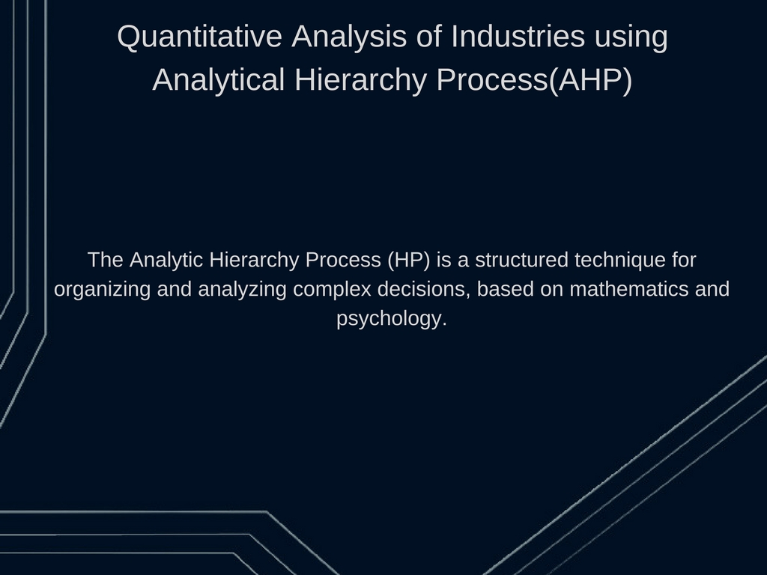
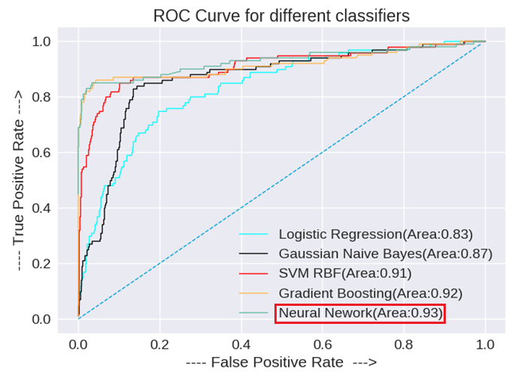
Model Selection
We decided to go with Area under ROC curve parameter. Classifiers were tested and the classifier with the highest Area Under ROC Curve (AUC-ROC) was selected.

Slide 12
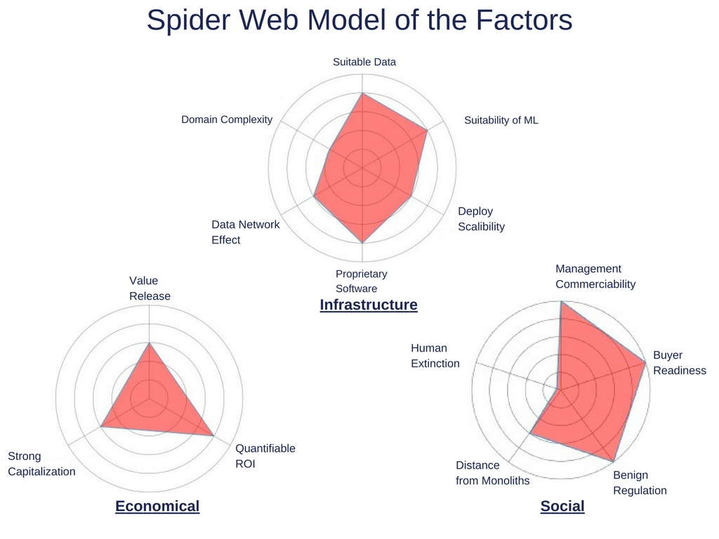
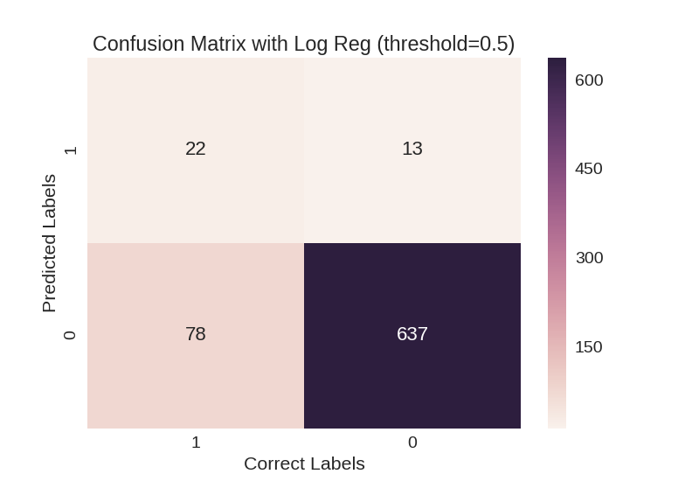
Logistic Regression
AUC: 0.833
Specificity: 0.98
Sensitivity/Recall: 0.22
Precision: 0.63

Slide 13
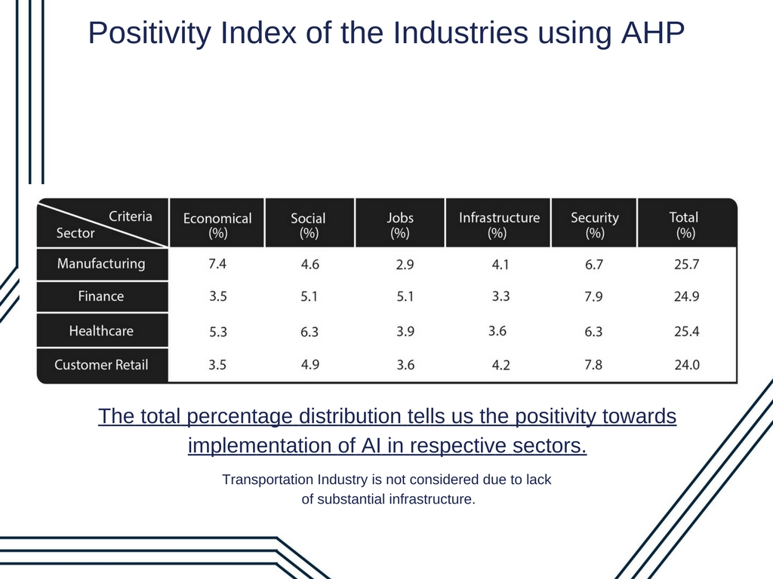
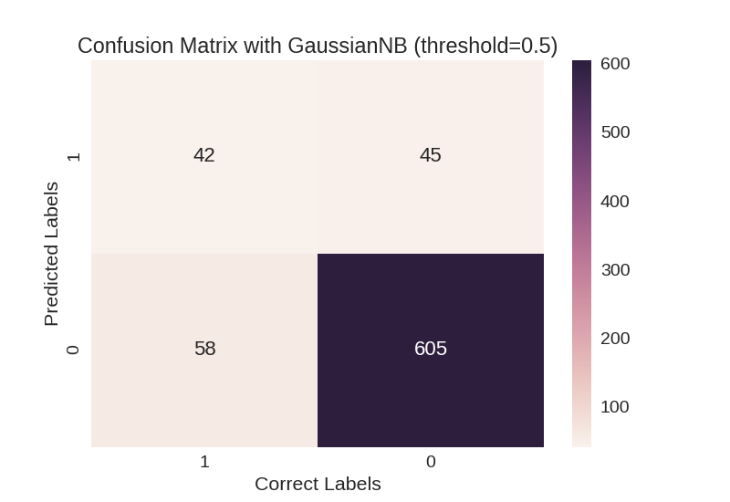
Naive Bayes’
AUC: 0.865
Specificity: 0.93
Sensitivity/Recall: 0.42
Precision: 0.48

Slide 14
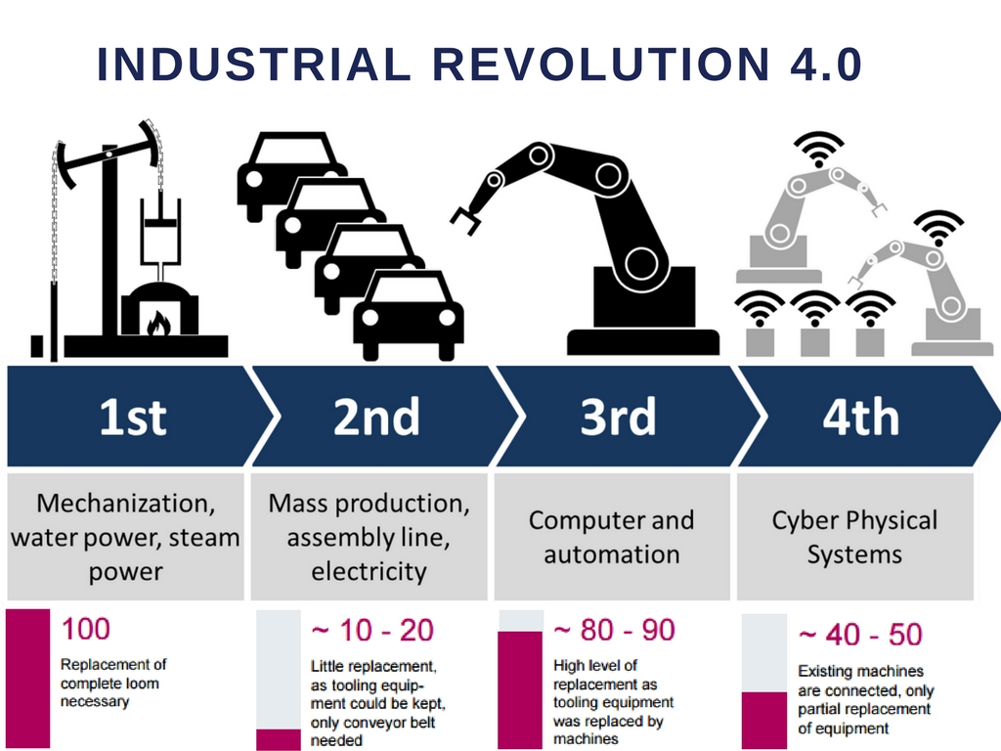
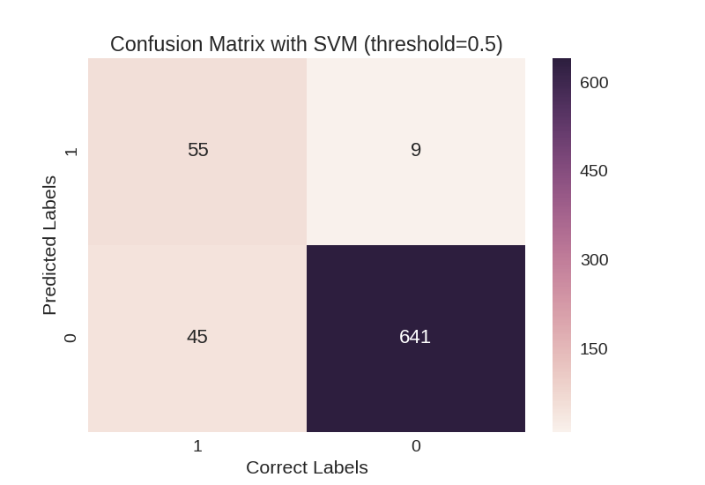
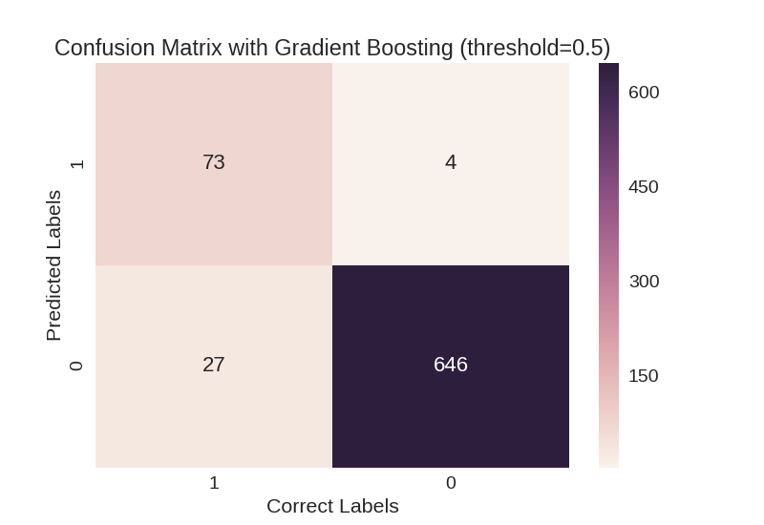
SVM Classifier
Gradient Boosting
AUC: 0.911
Specificity: 0.99
Sensitivity/Recall: 0.55
Precision: 0.86
AUC: 0.917
Specificity: 0.99
Sensitivity/Recall: 0.73
Precision: 0.95

Slide 15
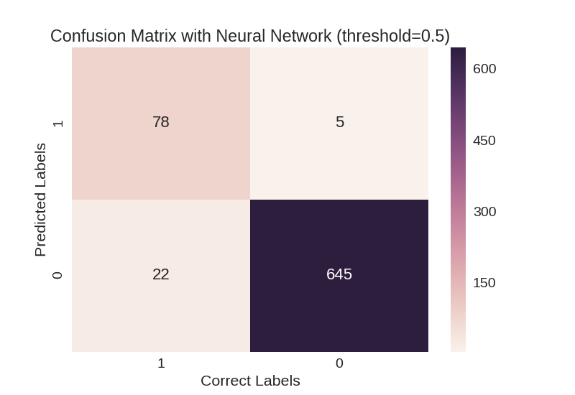
Neural Network
Selected Model
AUC: 0.927
Specificity: 0.99
Sensitivity/Recall: 0.78
Precision: 0.94

Slide 16
Threshold
Selection
Data
Pre-
processing
Variable
Analysis
Model
Selection & Confusion Matrix
Accuracy
Analysis
Index

Slide 17
Threshold Selection
As we saw at the threshold value of 0.5, we have high precision, however , Recall value is low.
To choose the right threshold value for classification we plotted different parameters like :
Youden Index: (Sensitivity + Specificity - 1)
Distance of the point from the upper left corner on the ROC curve
F-Beta value: : 2/(Fbeta)= (1/(beta*Recall)) + (1/(precision))
against varying thresholds

Slide 18
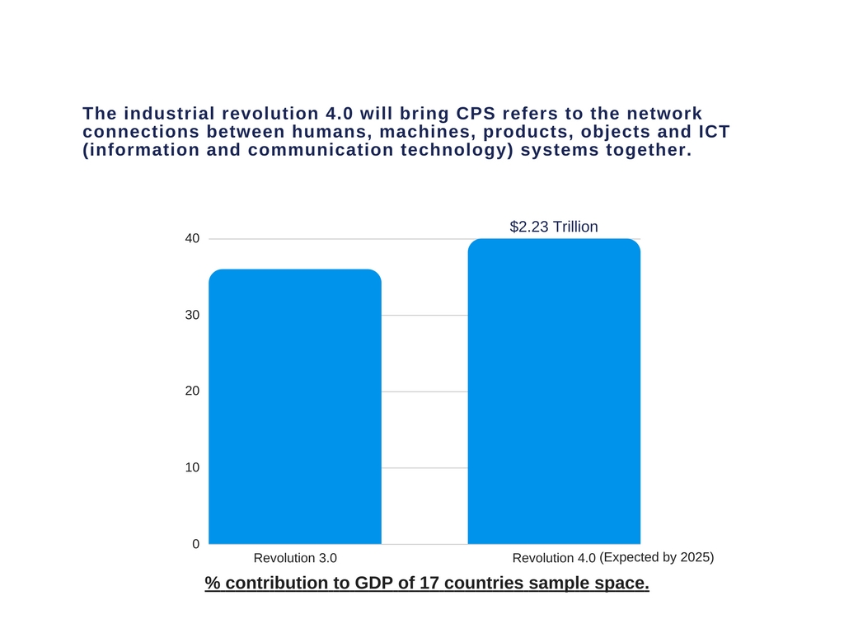
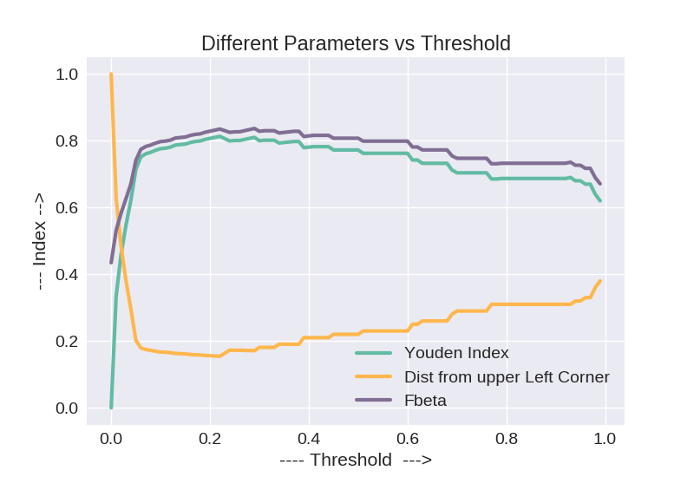
Selected Threshold: 0.29

Slide 19
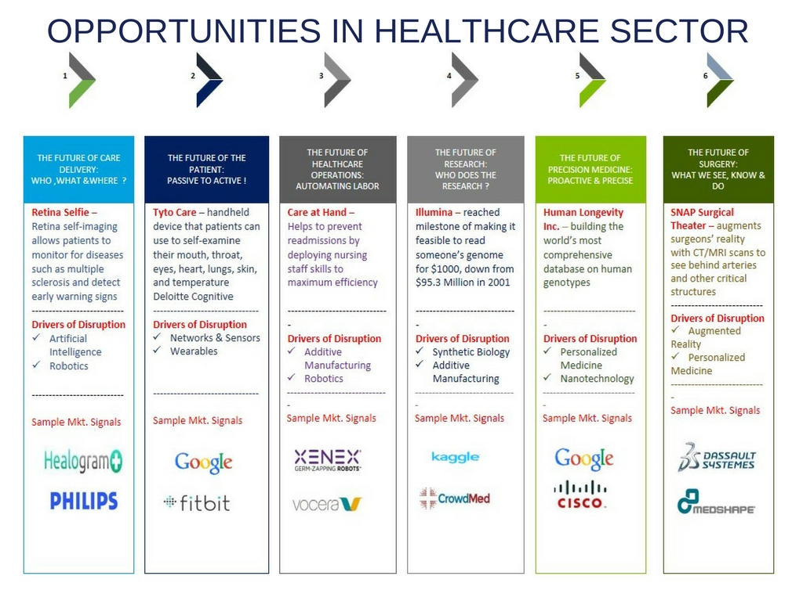
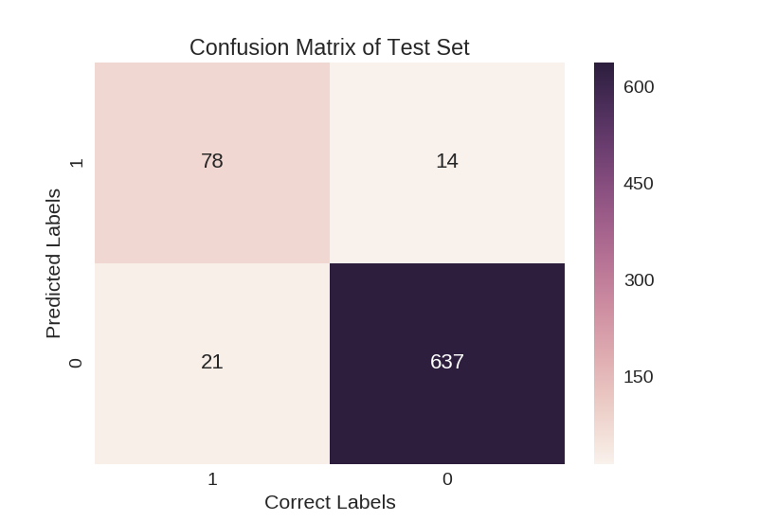
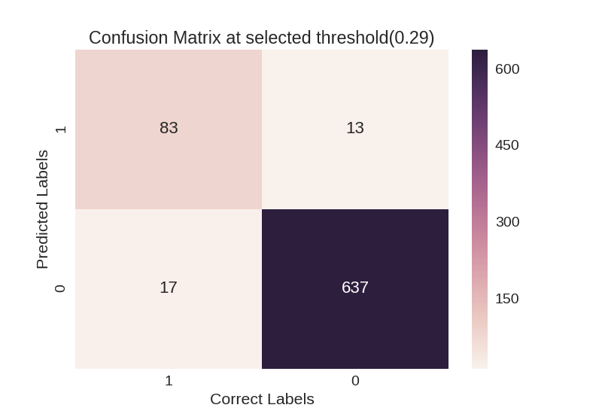
Confusion Matrix
Test Data
Validation Data
Specificity: 0.98
Sensitivity/Recall: 0.81
Precision: 0.85Test
AUC: 0.903233564524
Test Accuracy: 0.953333333333
Specificity: 0.98
Sensitivity/Recall: 0.83
Precision: 0.86
val AUC: 0.927284615385
val. Accuracy: 0.96

Slide 20

Accuracy
Analysis
Accuracy
Analysis
Data
Pre-
processing
Data
Pre-
processing
Variable
Analysis
Variable
Analysis
Model
Selection & Confusion Matrix
Model
Selection & Confusion Matrix
Threshold
Selection
Threshold
Selection
Index

Slide 21
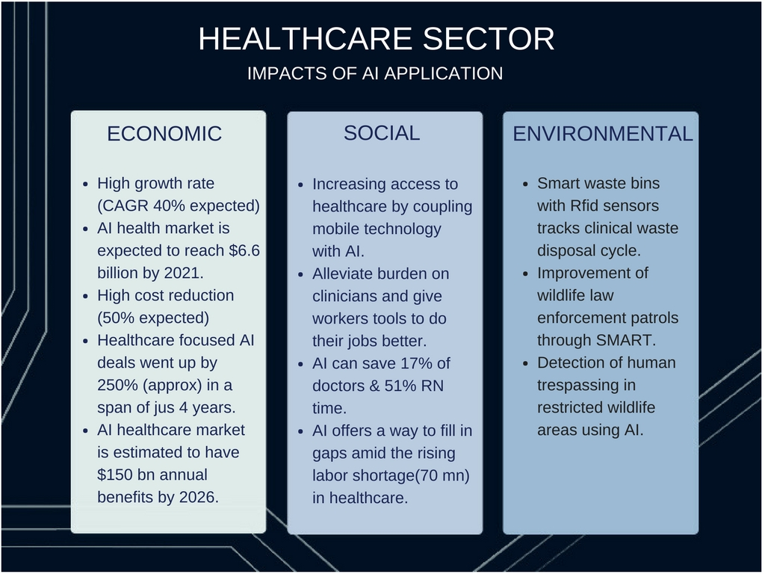
We analyzed the impact of each variable by omitting them and then observing the Area Under ROC Curve.
We reached to the conclusion that following had the most impact:
total_day_charge
number_customer_service_calls
international_plan
Variables like account_lenght has minimal effect. Finally, we observed that we had the highest Area Under ROC Curve when all the features(prepared dataset after variable analysis) were taken into consideration.

Slide 22

Alternative
Approach

Slide 23

Cost Analysis
For a Company, in order to balance to the budget along with the Retention and Acquisition costs, their balance of Recall and Precision can be dependent on cost of acquisition and cost of retention.

Slide 24
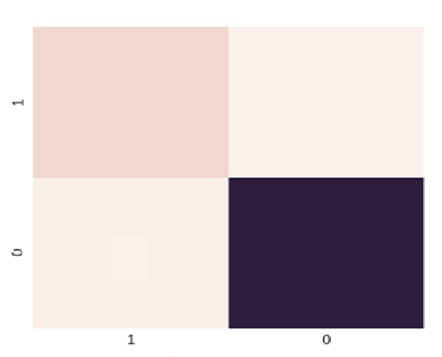
Approach Taken
Using our model, we would get the total number of customers leaving as TP+ FP so, we would be spending Cost of Retention on them.
While we would be spending Cost of Acquisition on FN number of customers.
TP
FP
FN
TN
Cost of Retention: Rs. 10/ person
Cost of Acquisition: Rs. 50/ person
Cost= 10(TP+ FP)+ 50(FN)

Slide 25
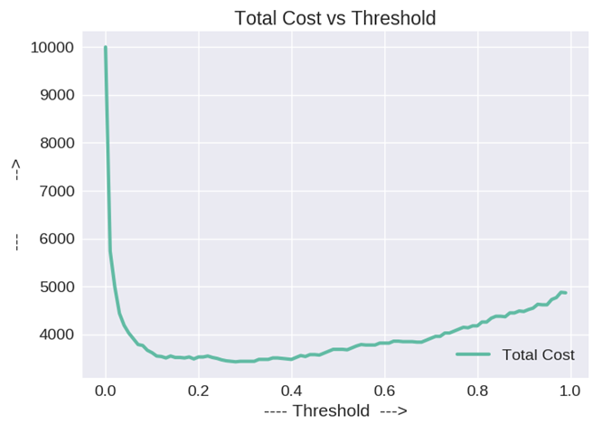
Cost
Selected Threshold: 0.28

Slide 26



Validation Data
Test Data
Specificity: 0.97
Sensitivity/Recall: 0.75
Precision: 0.83
val AUC: 0.882809916113 | Training AUC: 0.966490499186
val. Accuracy: 0.935
Specificity: 0.97
Sensitivity/Recall: 0.75
Precision: 0.8
Test AUC: 0.88829399415 | Test Accuracy: 0.942

Slide 27
Appendix

Slide 28
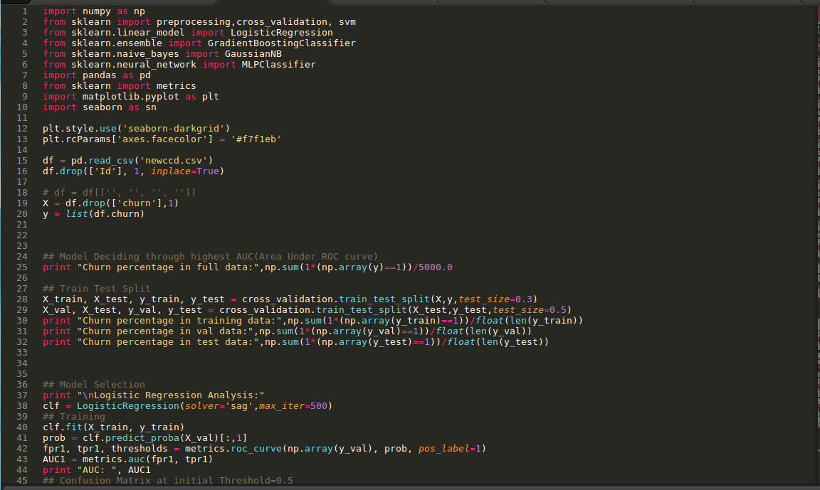

Slide 29
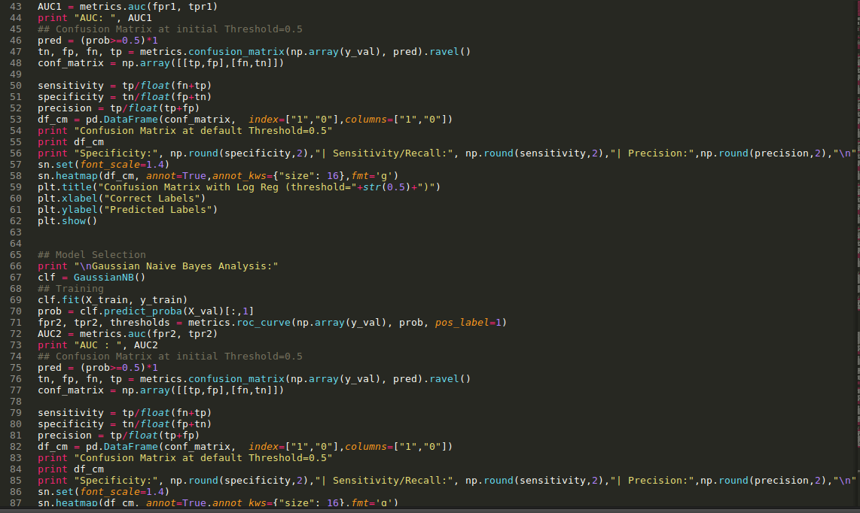

Slide 30
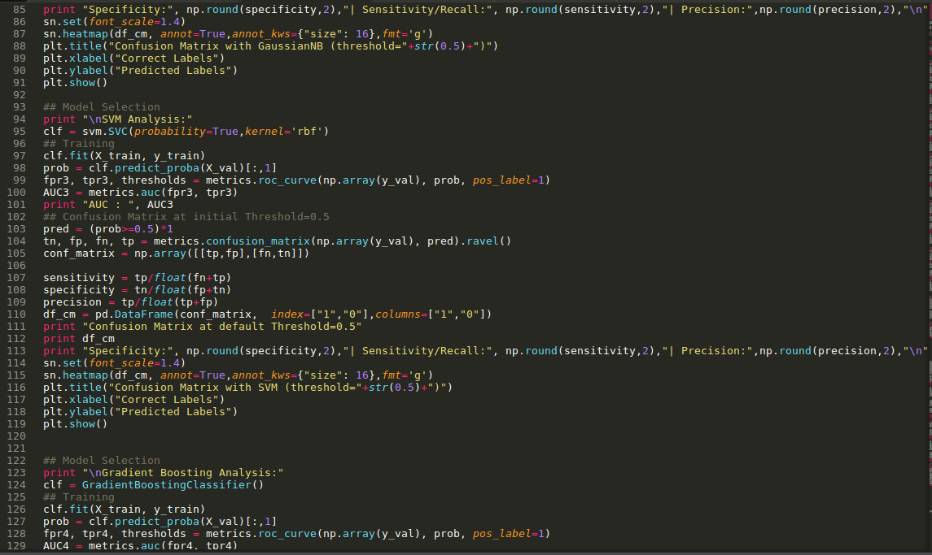

Slide 31
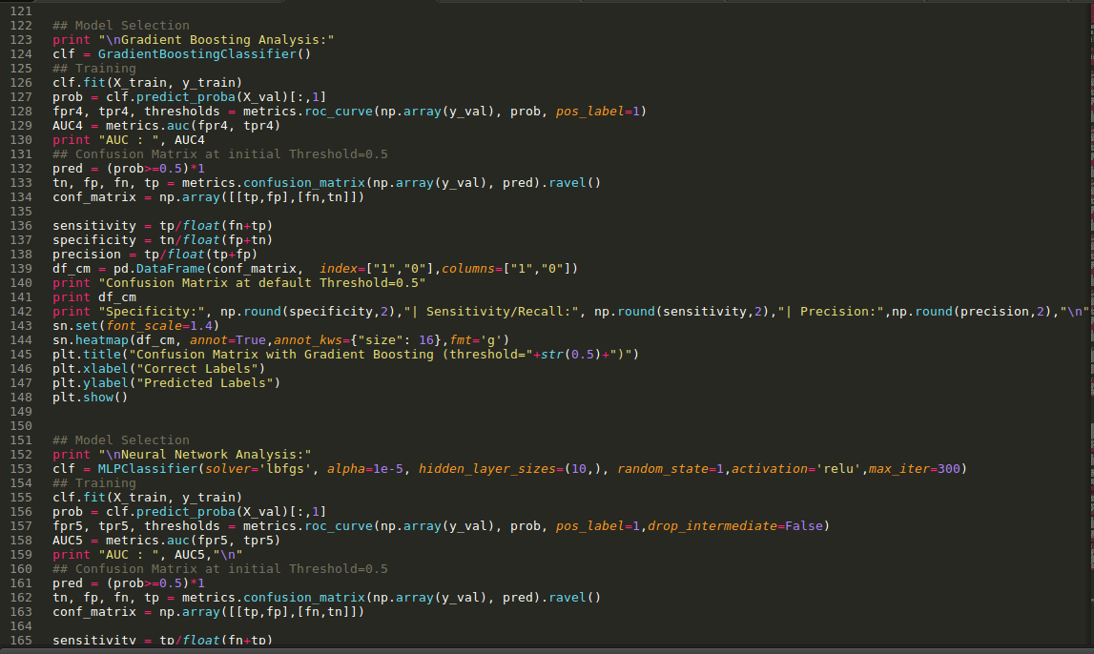

Slide 32
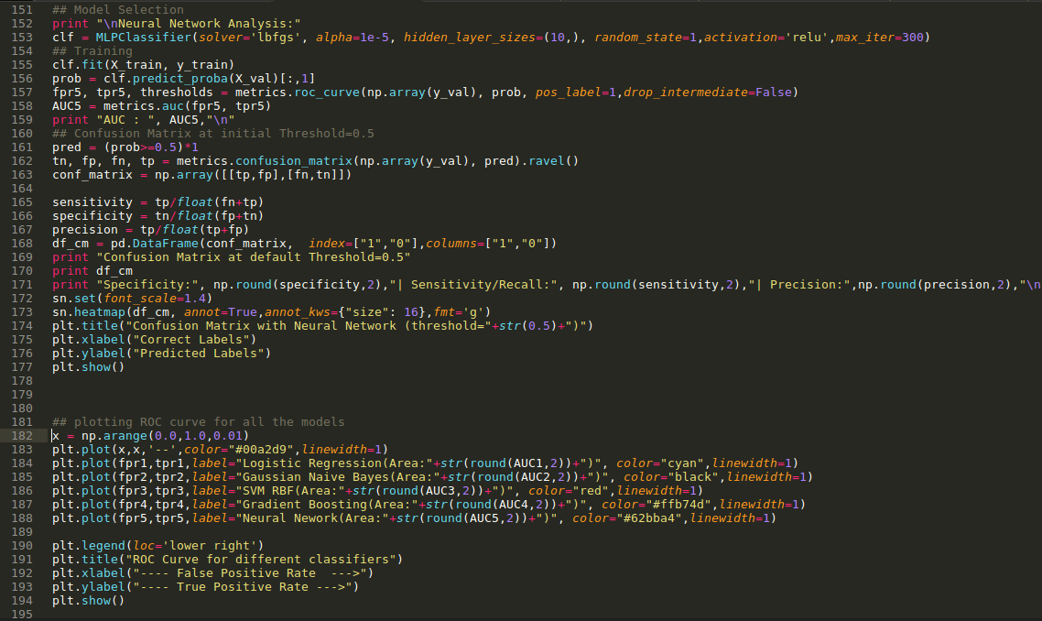

Slide 33
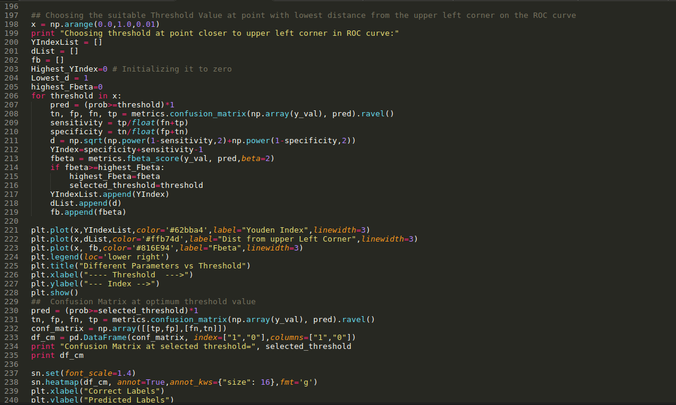

Slide 34
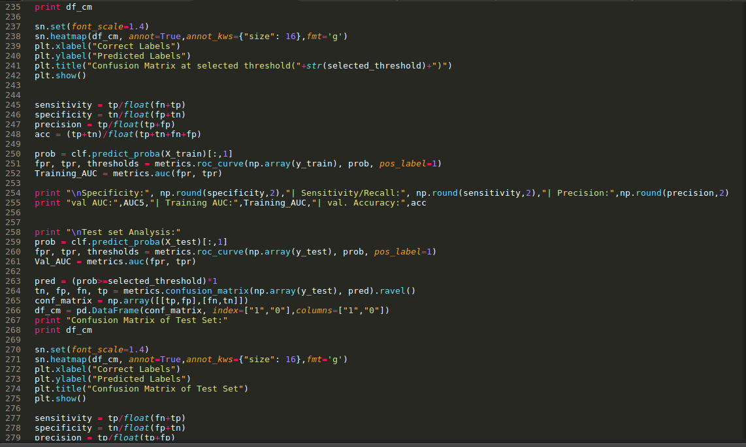

Slide 35
